Slide 1
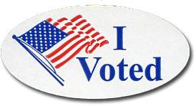
Elections and the American Electorate: 2012
?
Which Factors Best Explain Voter Turnout?
Group Member Names: Henry Lankin Gui Larangeira

Slide 2
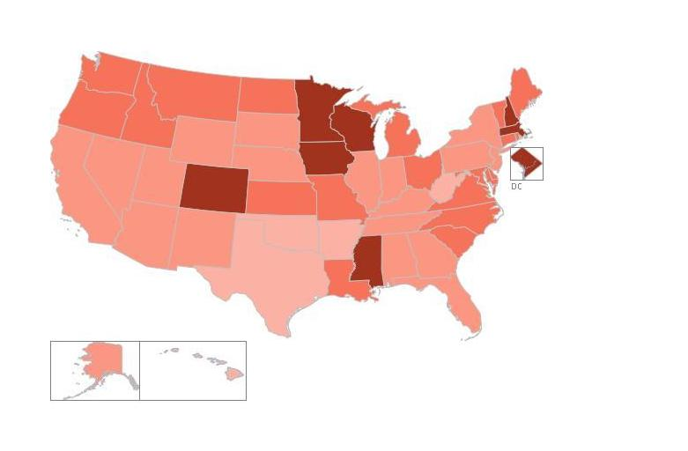
Goal and Motivation
To analyze the voter turnout in the 2012 elections and determine which factors best explain differences between states.
To determine which and how categorical and numerical variables such as age bracket, race and Hispanic origin, education, income and its political “color” (red, blue, or swing) influence the voter turnout of the state.
To determine if the proportion of eligible voters by race and Hispanic origin or other factors match the proportion of voter turnout by factors in the United States.
Percent Voted 2012
<45%
>70%

Slide 3
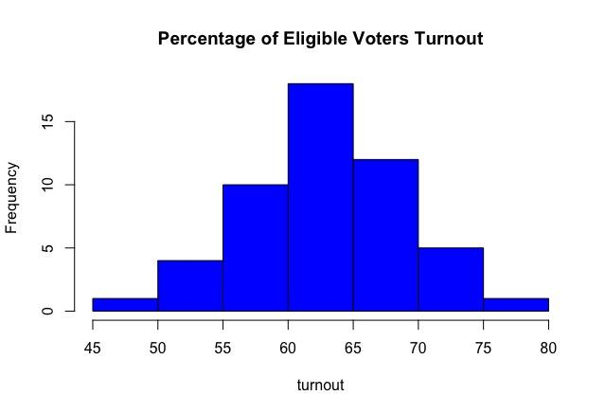
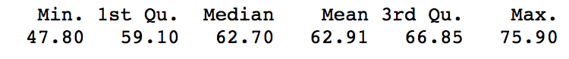
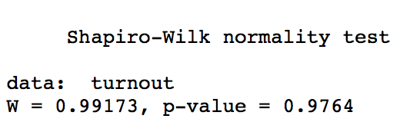
Our Dataset
Source: US CPS Current Population Survey
Voting and Registration in the Election of November 2012
Response variable:
Percent of eligible voters reported to have voted
Factors:
State color categorized as Red, Blue, or Swing
Education, Income, Age, and Race as compared to the national average (above and under)
Numerical variables:
Race: Percent of state that is Black, White, Asian and of Hispanic origin
Age: Percent of state by the age brackets of 18-44, 45-64, and 65 and over
Income: Median household income and poverty rate of the state
Education: Percent of state that is college educated (Bachelor’s degree or higher)

Slide 4
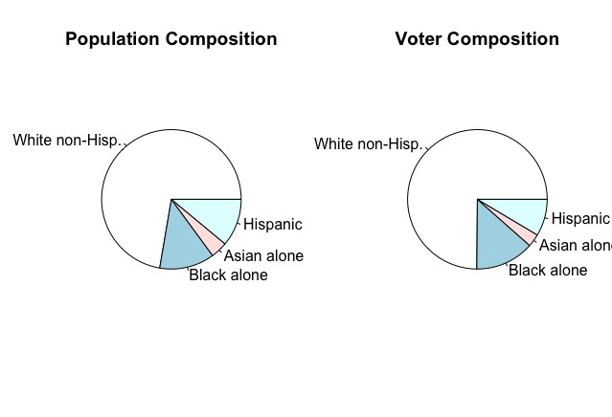
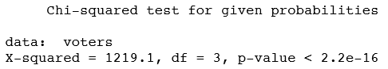
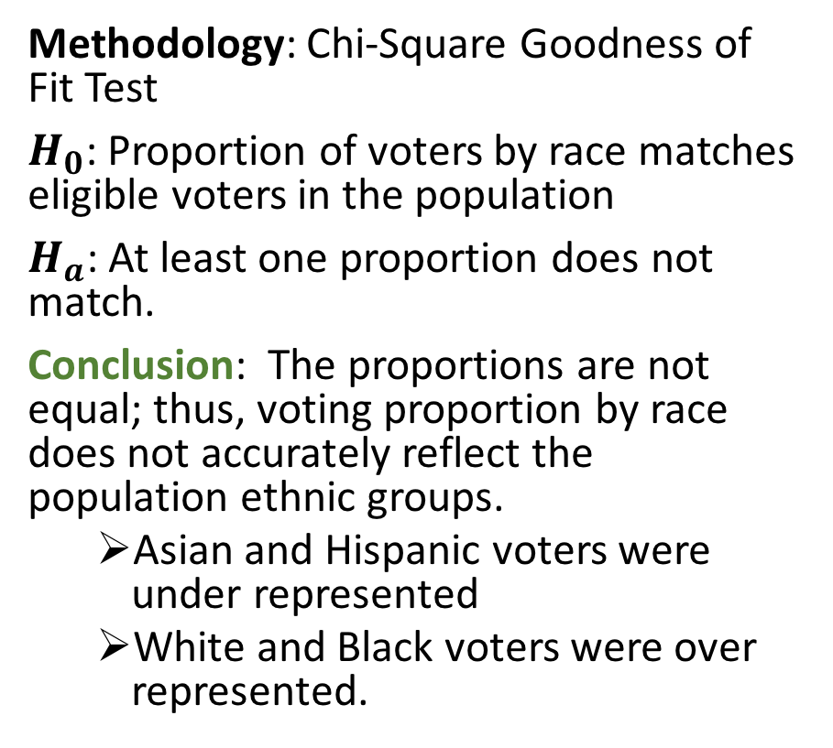
Race Composition of Voter Turnout
Methodology: Chi-Square Goodness of Fit Test
$H_{0}$: Proportion of voters by race matches eligible voters in the population
$H_{a}$: At least one proportion does not match.
Conclusion: The proportions are not equal; thus, voting proportion by race does not accurately reflect the population ethnic groups.
Asian and Hispanic voters were under represented
White and Black voters were over represented.

Slide 5
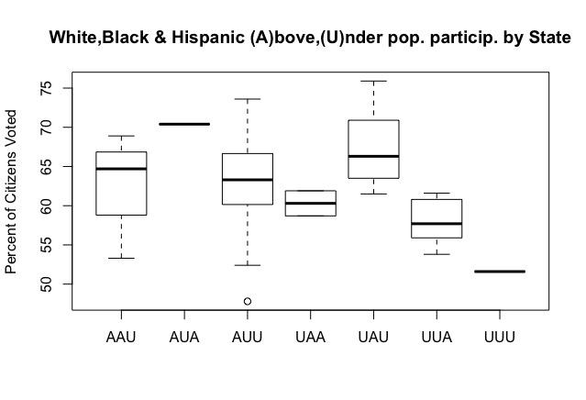
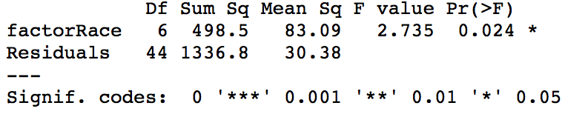
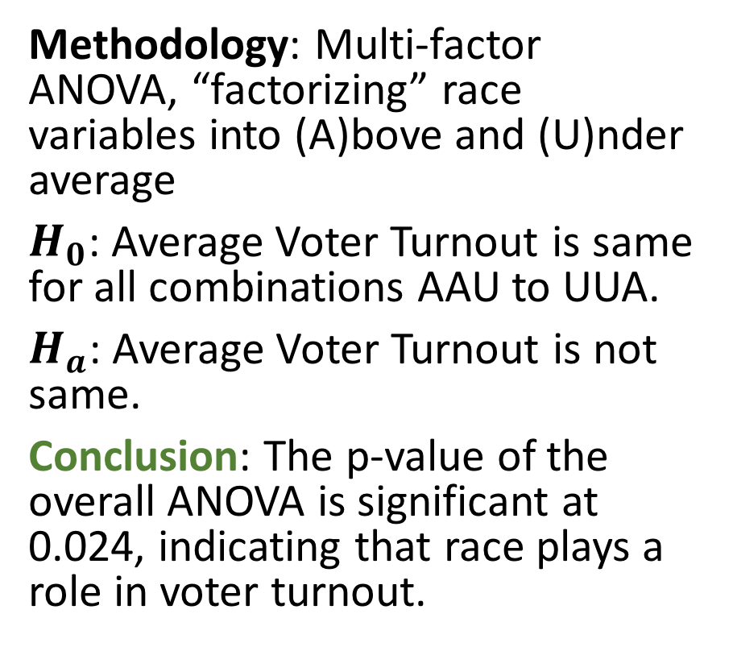
Voter turnout by Race
Methodology: Multi-factor ANOVA, “factorizing” race variables into (A)bove and (U)nder average
$H_{0}$: Average Voter Turnout is same for all combinations AAU to UUA.
$H_{a}$: Average Voter Turnout is not same.
Conclusion: The p-value of the overall ANOVA is significant at 0.024, indicating that race plays a role in voter turnout.

Slide 6
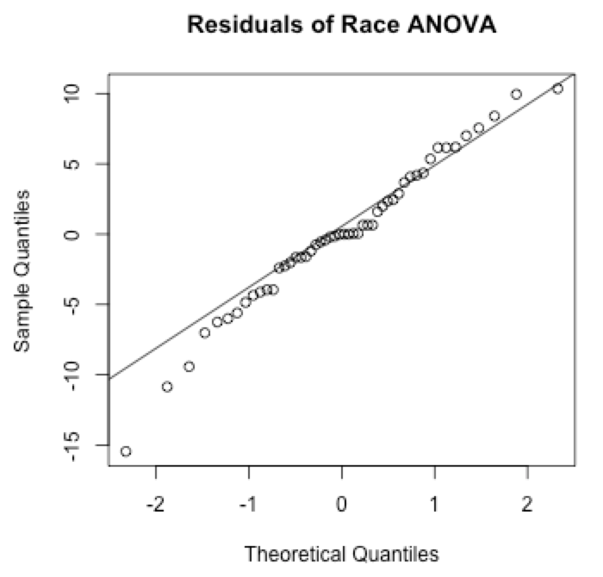
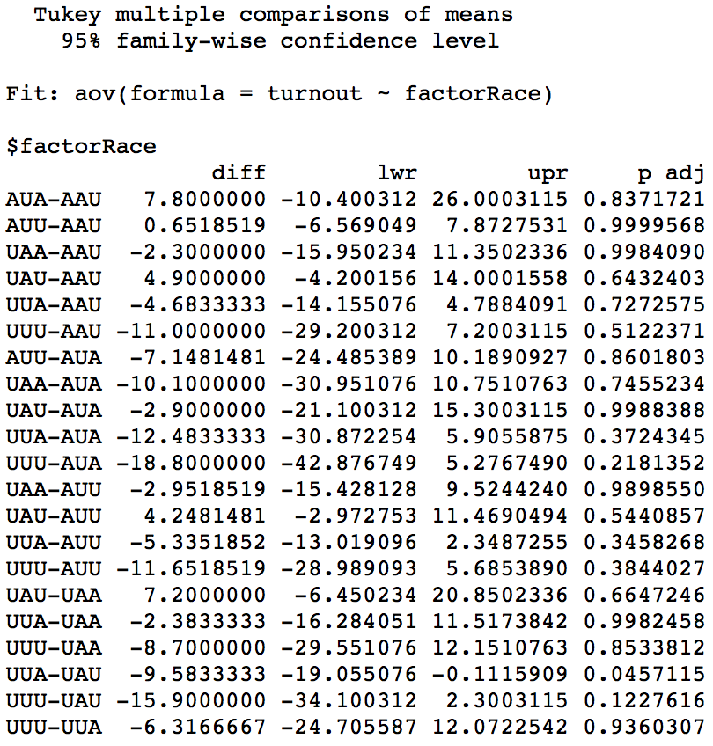
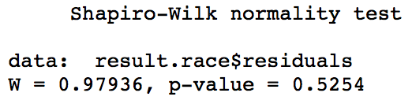
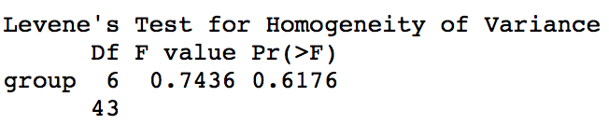
Paired Comparison for Race and Diagnostics
Conclusion of paired comparisons: Only the difference in voter turnout between the pairs UUA-UAU and UUU-UAU is significant at about 0.12.
Diagnostics: Conditions for the ANOVA model are met.
The residuals plot and Shapiro-Wilks test show that normality in the population cannot be rejected.
The Levene test shows that equal variances cannot be rejected.

Slide 7
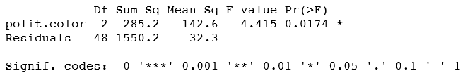
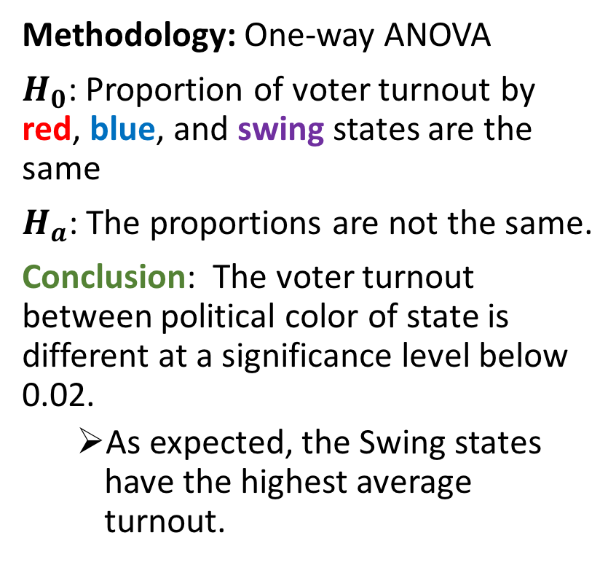
Voter Turnout by State Color
Methodology: One-way ANOVA
$H_{0}$: Proportion of voter turnout by red, blue, and swing states are the same
$H_{a}$: The proportions are not the same.
Conclusion: The voter turnout between political color of state is different at a significance level below 0.02.
As expected, the Swing states have the highest average turnout.

Slide 8
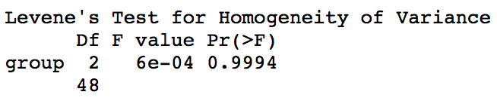
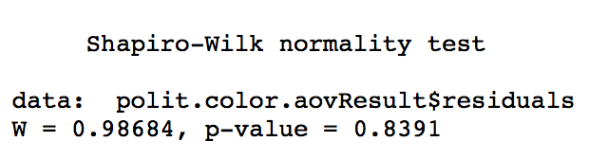
Diagnostics for Political Color
Conditions for the ANOVA model are met.
The residuals plot and Shapiro-Wilks test show that normality cannot be rejected.
The Levene test shows that equal variances cannot be rejected.

Slide 9
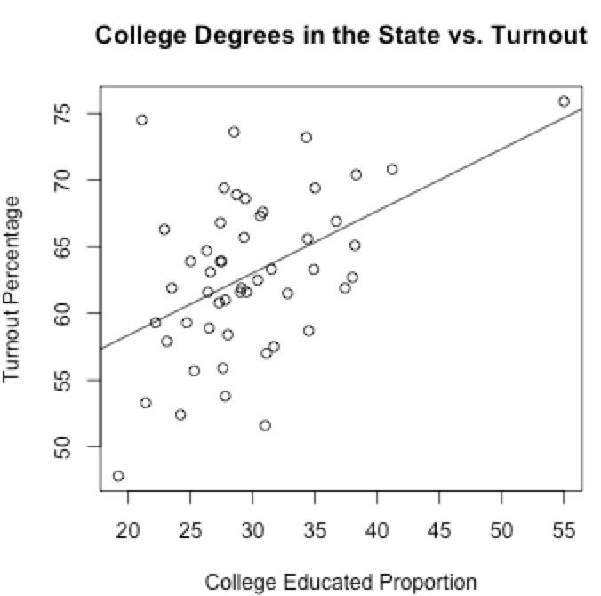
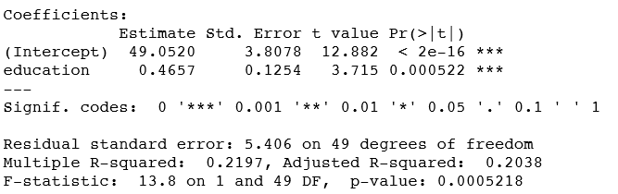
Percent College Educated
Methodology: Simple linear regression between percent of state that is college educated and voter turnout.
Conclusion: The regression line shows a positive correlation between percent of the state that is college educated and the voter turnout of the state.
Percent of college educated is quite significant (less than 1%) for voter turnout.

Slide 10
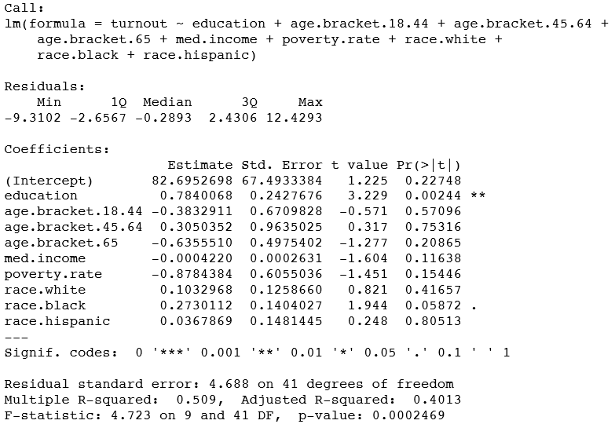
All Numerical Variables Combined
Methodology: Multi-linear regression
Conclusion: The correlation coefficient (multiple r² value) of the regression model is low and is likely affected by the noise of all the variables being included.
There is a high significance of less than 1% for education and the positive estimator confirms the result from the SLR of education.
There is also a fairly high significance of a little over 5% for Black race, confirming the results of the ANOVA and Goodness of Fit.

Slide 11
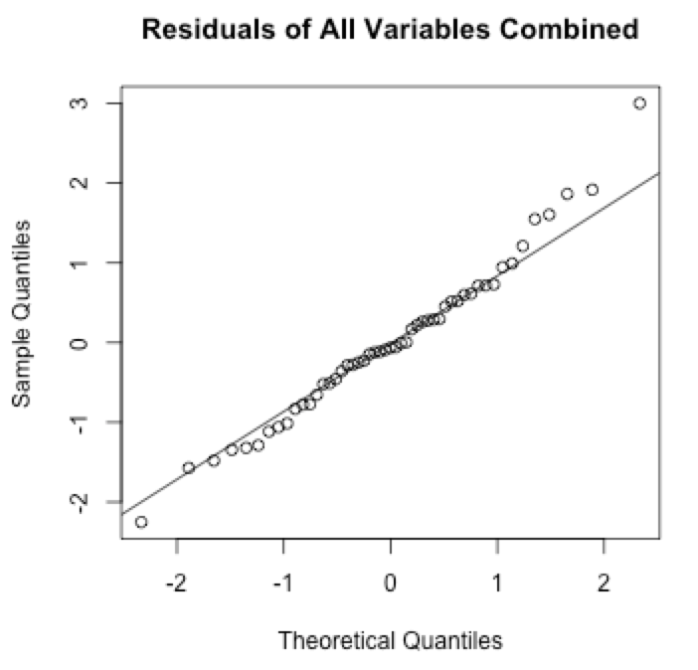
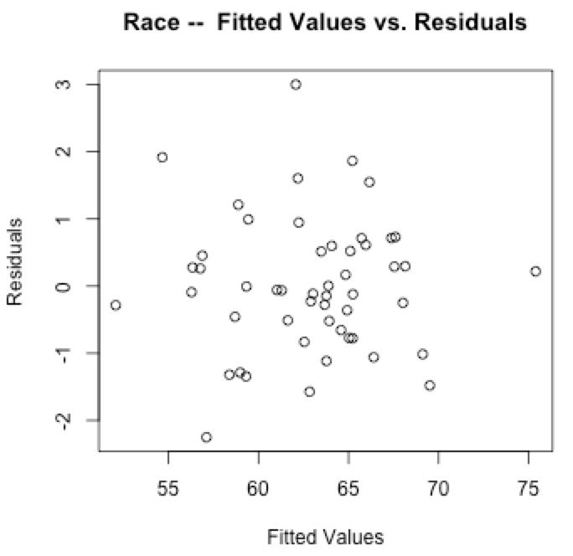
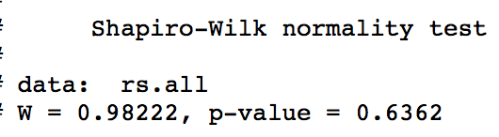
Diagnostics for Multi-Linear Regression
Conditions for the regression model are met.
The residuals plot and Shapiro-Wilks test show that normality cannot be rejected.
The residuals vs. fitted values plot shows that equal variances cannot be rejected.

Slide 12
Final Conclusion
!
Our dataset of over 50 states on the percent of eligible voter turnout has a normal distribution.
The composition of voters by race and Hispanic origin does not mirror the overall population of eligible voters.
Of the factors, state color has the most influence on voter turnout, with swing states clearly above average voter turnout.
Of the numerical variables tested, education has the most significant influence.
Policy recommendations to increase voter turnout:
Implement a direct popular vote and abolish the Electoral College so that we eliminate the bias introduced by different states.
Make voting day a national civic holiday so people can more easily participate in the vote.
Expand registration efforts and implement early voting and vote-by-mail options in more counties to increase voting participation.

Slide 13
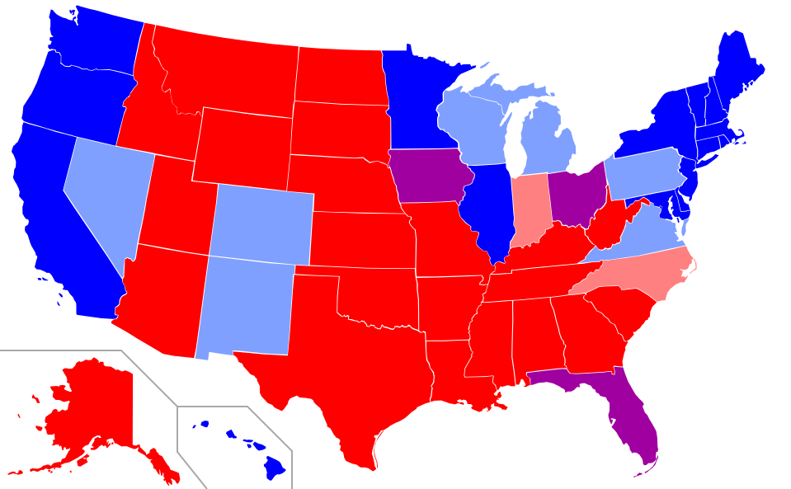
Appendix
Political Color ANOVA: Red, Blue and Swing States (1996-2012 Presidential Elections)

